Slide 1
Program Control: repetition
Algorithm and programming
Shania Priccilia, S.Kom., M.Kom.

Slide 2
Learning Objectives
At the end of this session, student will be able to:
Demonstrate usage of repetition/looping control operation in C programming language (LO2 & LO3)

Slide 3
Subtopics
Repetition Definition
For
While
Do-While
Repetition Operation
Break vs Continue

Slide 4
repetition DEFINITION
Repetition means executing one or more instructions multiple times.
The number of repetitions can be predefined (hard-coded in the program), or It can be determined at runtime based on user input or program. conditions.
Syntax:
for
while
do-while

Slide 5
repetition: for
syntax
for(exp1; exp2; exp3) statement;
or
for(exp1; exp2; exp3){
statement1;
statement2;
……
}
exp1 : initialization
exp2 : conditional
exp3 : increment or decrement
exp1, exp2 and exp3 are optional

Slide 6
repetition: for
syntax
exp1 and exp3 can consist of several expression separated with comma
Example:
void reverse(char ss[])
{
int c,i,j;
for(i=0, j=strlen(ss)-1; i<j; i++, j--){
c=ss[i];
ss[i]=ss[j];
ss[j]=c;
}
}

Slide 7
repetition: for
flowchart
Flow Chart of FOR Statement
exp1
exp3
statements
true
exp2
false

Slide 8
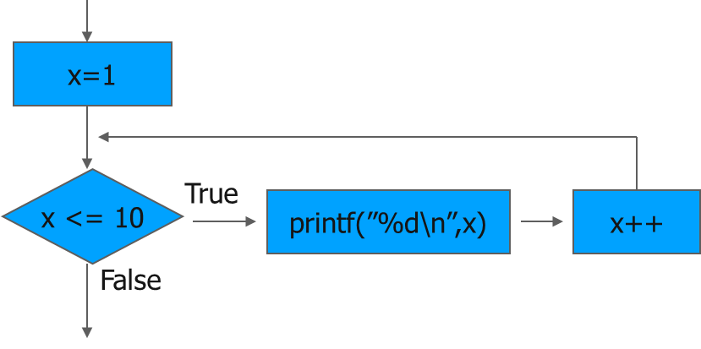
repetition: for
example
for (x=1; x <= 10; x++) printf("%d\n", x);

Slide 9
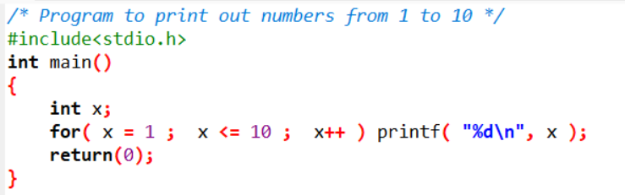
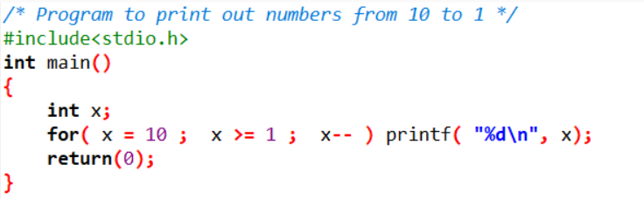
repetition: for
example

Slide 10
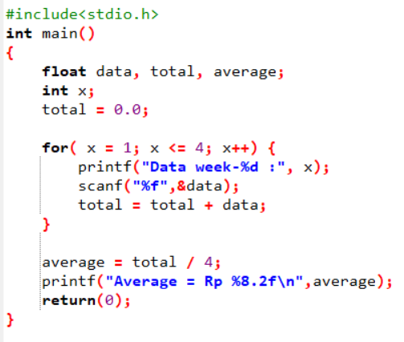
repetition: for
example
Example:
Calculating average of monthly expenses:
Week Expenses
1 Rp. 32.000,-
2 Rp. 29.000,-
3 Rp. 33.000,-
4 Rp. 24.000,-
Algorithm :
Create and empty total
Read from keyboard and save to data
Add data to total
Repeat 2 and 3 four times
Average = total / 4

Slide 11
repetition: for
Infinite loop & nested loop
Infinite Loop
An infinite loop is a loop that has no stopping condition.
In C, it can be written using a for loop with all three components omitted.
Use break to end the loop.
Nested Loop
A nested loop is a loop inside another loop.
The inner loop completes all its repetitions for each iteration of the outer loop.
The repetition operation will start from the inner side loop.

Slide 12
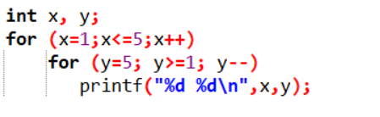
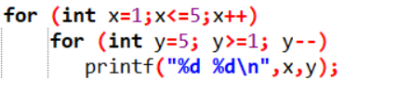
repetition: for
nested loop example
C (.c)
Output:
1 5
1 4
1 3
1 2
1 1
2 5
2 4
2 3
2 2
…
5 1
C++ (.cpp)

Slide 13
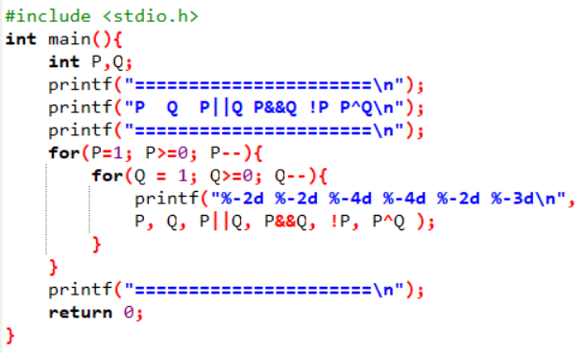
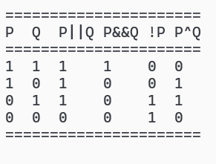
repetition: for
nested loop example
Truth Table
Output:

Slide 14
Repetition: WHILE
syntax
while (exp) statements;
or
while(exp){
statement1;
statement2;
…
}
exp is Boolean expression. It will result in true (not zero) or false (equal to zero).
Statement will be executed while the exp is not equal to zero.
exp evaluation is done before the statements executed.

Slide 15
Repetition: WHILE
flowchart
Flow Chart of WHILE Statement
statements
condition
true
false

Slide 16
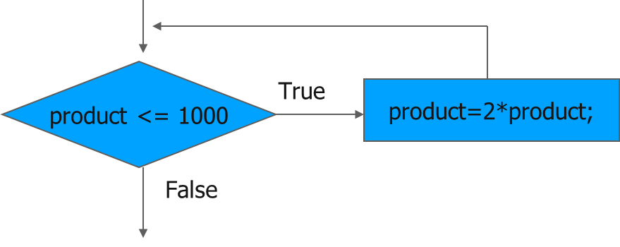
repetition: while
example
while(product <= 1000) product = 2*product;

Slide 17
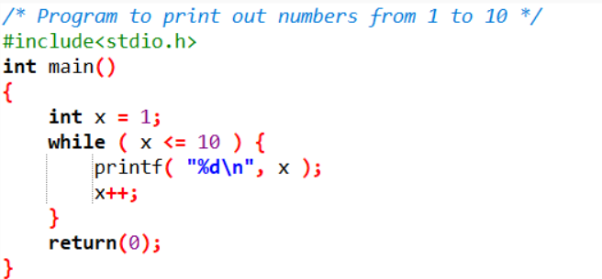
repetition: while
example
These code are analogous

Slide 18
Repetition: do-WHILE
syntax
do{
statements;
} while(exp);
Keep executing while exp is true
exp evaluation done after executing the statement(s)

Slide 19
Repetition: do-WHILE
flowchart
Flow Chart of DO-WHILE Statement
statements
true
condition
false

Slide 20
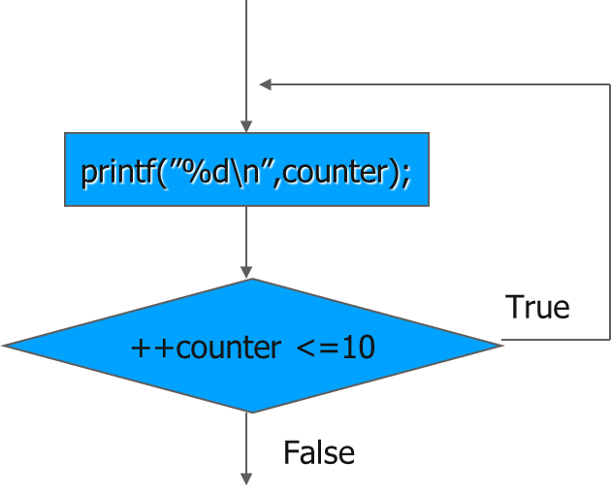
repetition: do-while
example
do{
printf(”%d\n”,counter);
} while(++counter <=10);

Slide 21
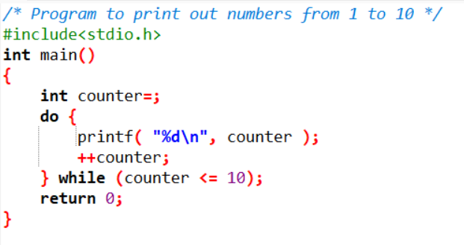
repetition: do-while
example

Slide 22
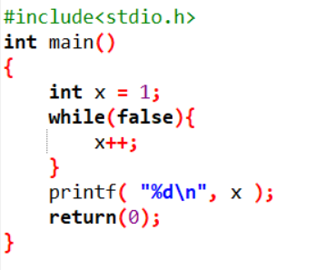
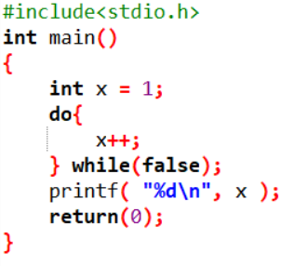
repetition: do-while
While vs do-while
In while operation, statement block of statements may never be executed at all if exp value is false
In do-while on the other hand statement block of statements will be executed min once
Output:
1
Output:
2

Slide 23
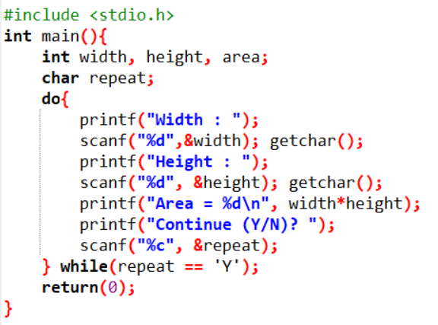
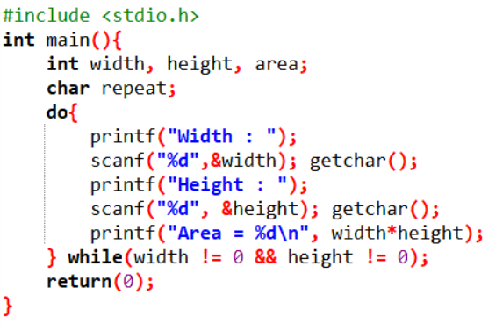
Repetition operation
To end the repetition, can be done through several ways:
Sentinel
Question, should the repetition continue?
Example Question
Example Sentinel (used 0 for width or height)

Slide 24
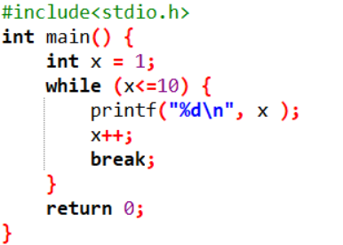
Repetition operation
break
Break is to force finish the loop
end the loop

Slide 25
Break vs continue
Definition
break:
Immediately exit a loop (for, while, or do-while) before the loop condition becomes false.
Terminate a switch statement, preventing fall-through to the next case.
continue:
Skip the remaining statements inside a loop for the current iteration. Execution then proceeds with the next iteration of the loop.

Slide 26
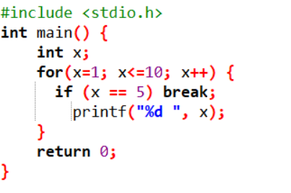
Break vs continue
break example
Output
1 2 3 4

Slide 27
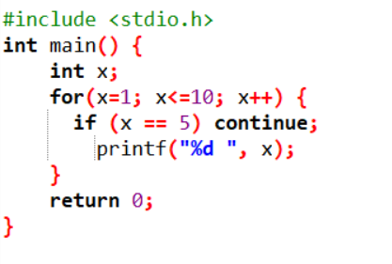
Break vs continue
continue example
Output
1 2 3 4 6 7 8 9 10

Slide 28
exercise
Question 1
Given the following code:
for (i=k; i < n; i++) printf("Binus\n");
If k < n how many times the statement executed?
If k = n how many times the statement executed?
If k > n how many times the statement executed?
Question 2
Given the following code:
for (i=k; i >= n; i--) printf("Binus\n");
If k < n how many times the statement executed?
If k = n how many times the statement executed?
If k > n how many times the statement executed?

Slide 29
exercise
Question 3
If p = statement and e = expression, rewrite the following for loop to while loop.
for(; e ;) p;
for(; ; e) p;
Question 4
Compare and describe their output:
for (i=0, j=1; i<8; i++, j++) printf("%d + %d = %d\n", i, j, i+j);
for (i=0, j=1; i<8; ++i, ++j); printf("%d + %d = %d\n", i, j, i+j);

Slide 30
exercise
Question 5
Explain the output:
#include<stdio.h>
int main() {
int score = 0, total= 0;
while(score < 10) {
total += score;
printf("Score =%d, Total =%d\n", score++, total);
}
return 0;
}

Slide 31
exercise
Question 6
Explain the output:
#include<stdio.h>
int main() {
long number, tmp, x=1;
printf("Input number: "); scanf("%d", &number);
tmp=number;
while(number>= 1) x*=number--;
printf("%ld! = %ld",tmp, x);
return 0;
}

Slide 32
exercise
Question 7
Create a program using C to display odd numbers from 11 to 188, using :
for
while
do-while
Question 8
You are given a list of integers, each representing a number of days after 1st January 2024, which was a Monday, 2nd is Tuesday, and so on. For each number, determine what day of the week it falls on.
Sample Input | Sample Output
3 8 12 7 | Monday Friday Sunday

Slide 33
SUMMARY
Repetition is a condition which is one or more instruction repeated for certain amount of time
3 types of repetition/looping in C:
for
while
do-while

Slide 34
REFRENCES
Paul Deitel & Harvey Deitel. (2021). C how to program. 09. Pearson Education. New York. ISBN: 9780137398393.
C For Loop: https://www.programiz.com/c-programming/c-for-loop
Doing the Same Thing Over and Over: http://aelinik.free.fr/c/ch07.htm

